Slide 1
COURSE COMPLETION STATUS
INHYD - D-TAP DEVOPS

Slide 2
February | March | April | May | Yet to Complete
Introduction to Software Methodologies, Cloud Computing and DevOps | Virtualization and Containerization | Container Orchestration Tool – Kubernetes (K’8) | Testing and Test Automation Tool - Selenium | CI/CD pipelining Implementation
Intro to AWS, Linux, DevOps Tools | Microservices and Networking | Networking and Rest API | Container Orchestration Tool(K’8) | Capstone Project on DevOps
Intro to Source Code Management Tool | Databases(RDS,MYSQL,Aurora,Postgress) | Configuration Management Tool - Ansible
AWS Services (IAM,EC2,S3...etc) | Containerization Tool - Docker | Continuous Automation Server - Jenkins | Certification Path
Introduction to Scripting Language | Infrastructure as code(IAAS) | Build Automation Tool – Maven
Python Frameworks and libraries(Flask)
AWS Cloud Practitioner Essentials

Slide 3
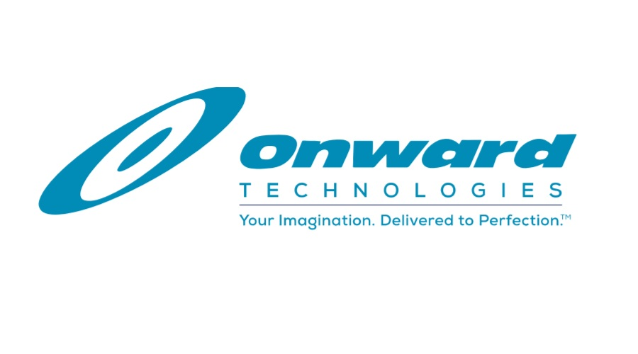
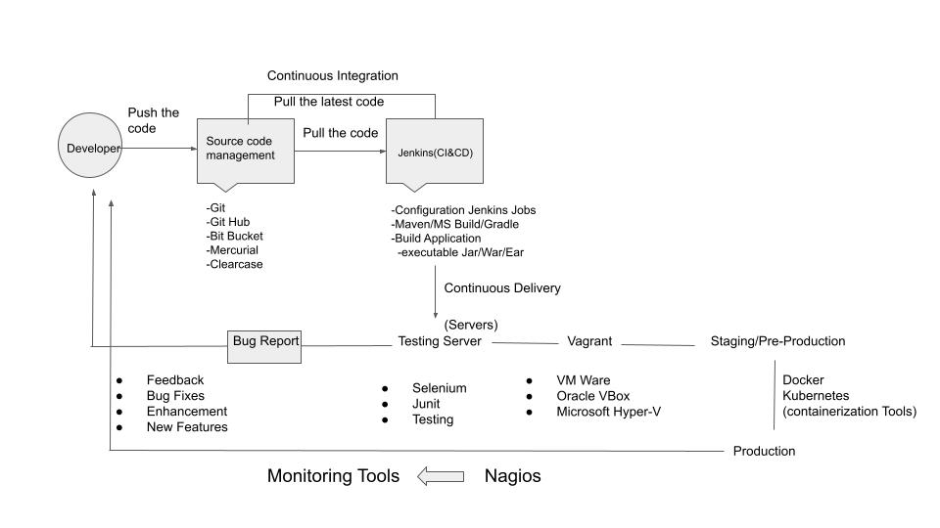
WORK FLOW

Slide 4
Overall Syllabus Completion Status
AWS Cloud Practitioner Certification Status

